Slide 1
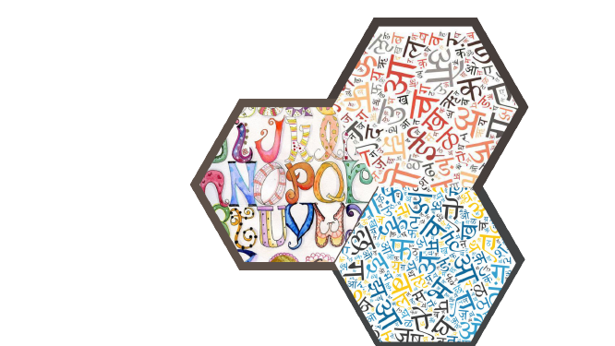
Translatish
NLP Project
(CSC306)
Guided by
Prof. Jaideep Raulji
Prof. Vinay Vachharajani

Slide 2
Team Members
Enrollment No. | Name
AU1841004 | Aanshi Patwari
AU1841052 | Dipika Pawar
AU1841057 | Mayankkumar Tank
AU1841076 | Rahul Chocha
AU1841125 | Yash Patel

Slide 3

Introduction
As in our country India, the national language is considered to be Hindi and it is spoken all over the country, translation of any videos into Hindi can help reach maximum audience.
Most of the population of our country is unable to communicate in English, they cannot understand English language videos. So, translation of such video becomes necessary.
So, to reach a wider audience and make videos available in other languages, we decided to translate the English language videos into Hindi
language.
Video translation includes transcription, translation,
subtitling, and voice-overs.

Slide 4
Steps involved
Extract the audio from video
Convert the audio into text using API
Convert the language from English to Hindi
Main focus areas of project are:
Preprocess the data
Train the model
Test the model ( Actual conversion of the input )
Performance measure

Slide 5
Existing Status of Project
Dataset Collection ✔
HindiEnglishCorpora - containing TED talks, news articles and wikipedia articles
Data preprocessing ✔
Removal of duplicate and null records ✔
Conversion to lowercase ✔
Removal of Quotes, Special characters, digits and extra spaces. ✔
Model implementation ✔

Slide 6
Literature Review
Comparison of LSTM and RNN
GRU values are also close to LSTM values with lesser run time in comparison to RNN.
The LSTM layer architecture is instead built in such a way the the network “decides” whether to modify its “internal memory” at each step.
Doing so, and if properly trained, the layer can keep track of important events from further in the past, allowing for much richer inference.
LSTM networks were made with one purpose in mind — to solve long term dependency problems that traditional RNNs have.
LSTM networks are specially made to solve long-term dependency problems in RNNs and they are super good at making use of data from a while ago (inherent in its nature) by using cell states and RNN has a complex structure which in turn has more computations therefore making LSTM more preferred over RNN.

Slide 7
Challenges and solutions to the problems faced during project
Different versions not supporting each other’s versions so had to rebase all to a common version adaptable and working for all.(E.g:- TF=2.0.0, Keras=2.1.5)
Setting the parameters for the model(for speeding up the model building process)
RAM crash error due to running the code onto the whole dataset. So we tried to implement the code on a part of the dataset.
Shift from the Google Colab to Kaggle Notebook as it provides more space and RAM as compared to colab which increased the computation speed to a larger extent.

Slide 8
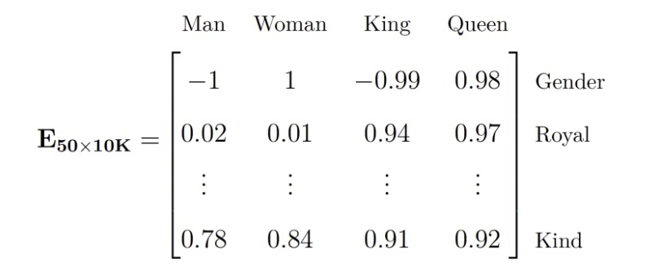
Word embedding
Source : https://medium.com/analytics-vidhya/neural-machine-translation-for-hindi-english-sequence-to-sequence-learning-1298655e334a

Slide 9
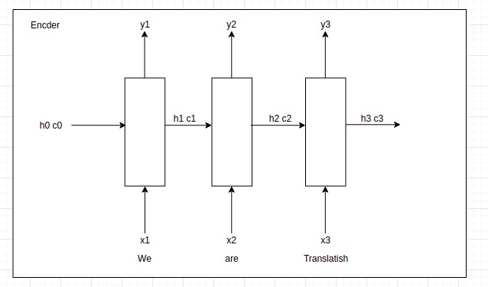
Structure of LSTM Encoder

Slide 10
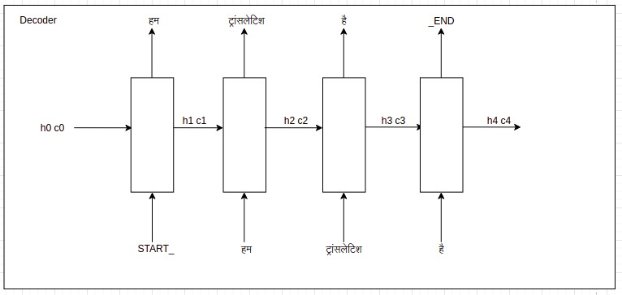
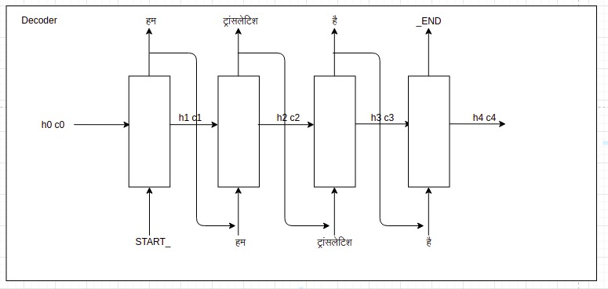
Structure of LSTM Decoder
Training Decoder
Testing Decoder

Slide 11
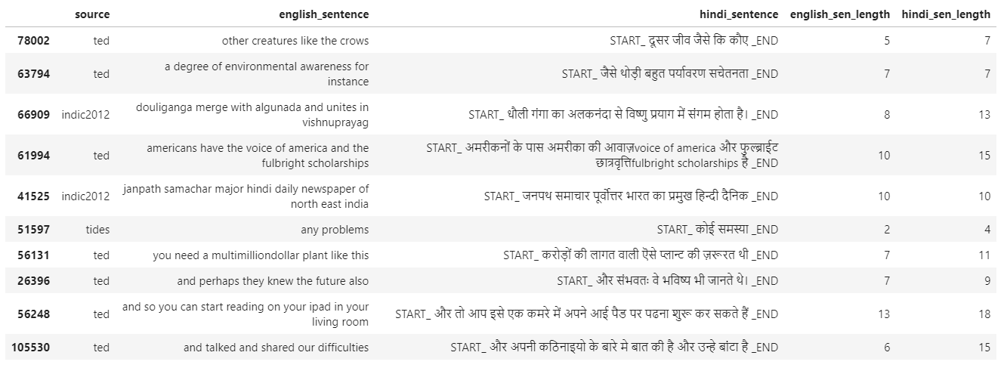
Results
Output data after Cleaning and Preprocessing

Slide 12
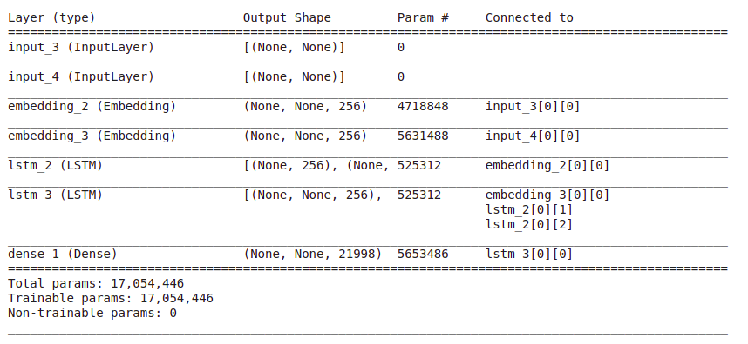
Results
Model Summary

Slide 13
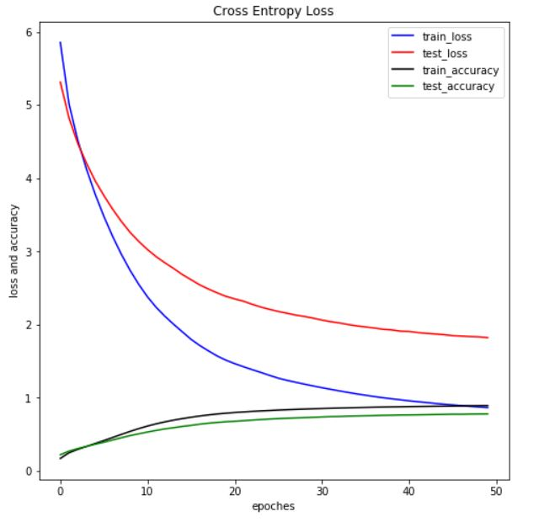
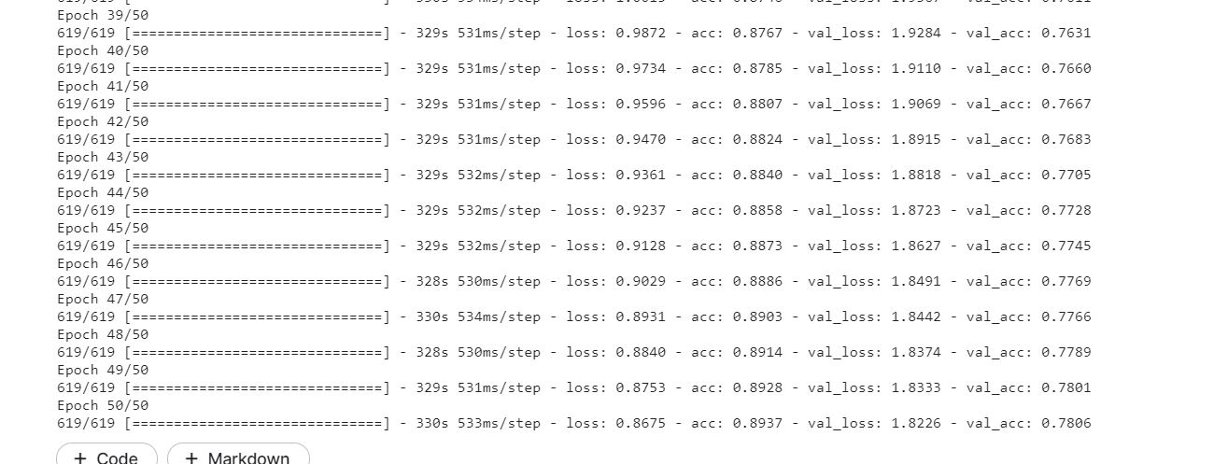
Results
Model Training-Validation:

Slide 14
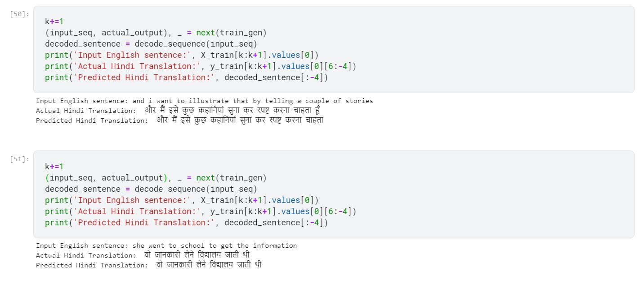
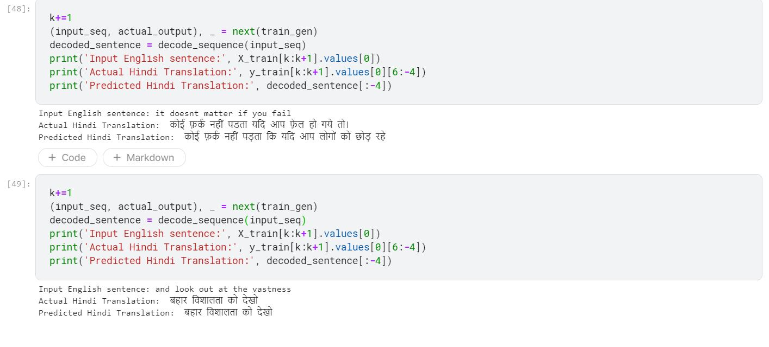
Results
Model Testing:
Image 1
Image 2

Slide 15
Future work
Optimization of Model
Speech to text using inbuilt library
Text to speech using inbuilt library
Web app development (End to End product)

Slide 16
References
Neural Machine Translation For English To Hindi
Machine Learning Translation using Deep Learning: An Overview
Dataset
seq2seq LSTM model
Encoder-Decoder LSTM model explanation
LSTM using TF Keras

Slide 17
Thank you!
Notes:
Bleu - for accuracy

